Slide 1
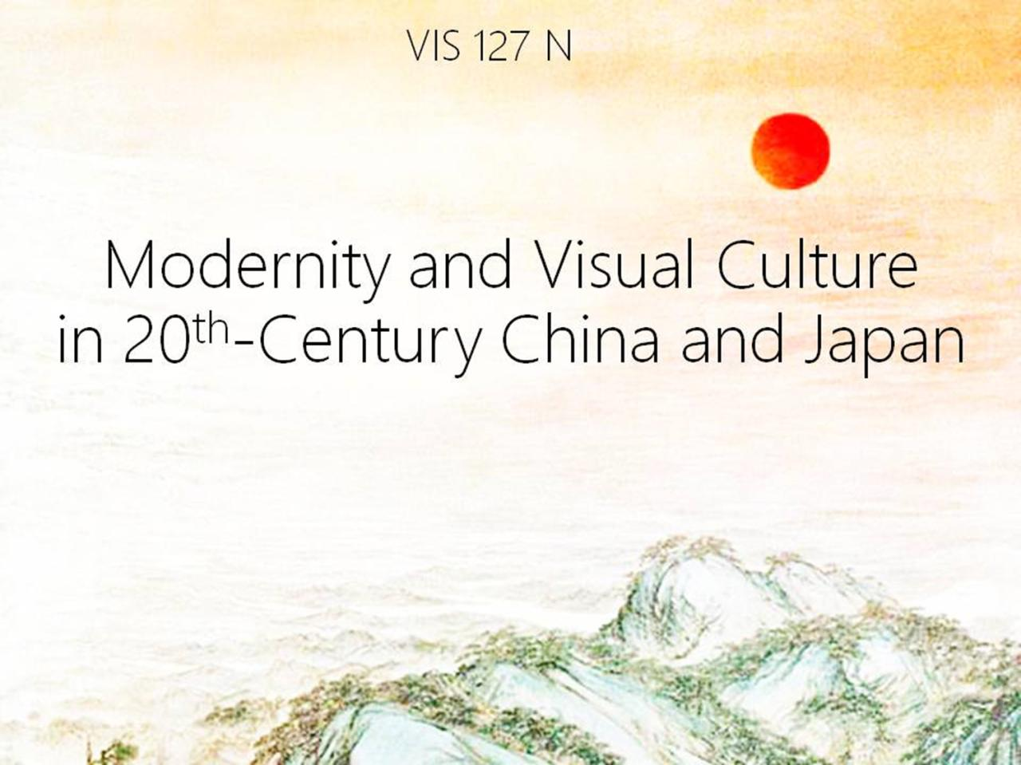

Slide 2
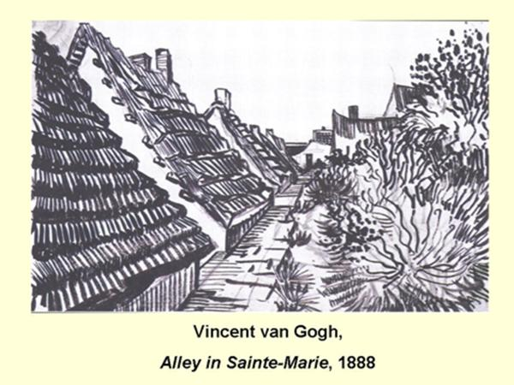

Slide 3
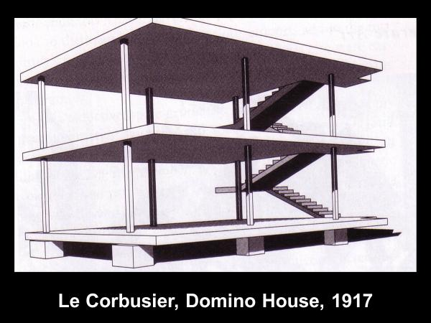

Slide 4
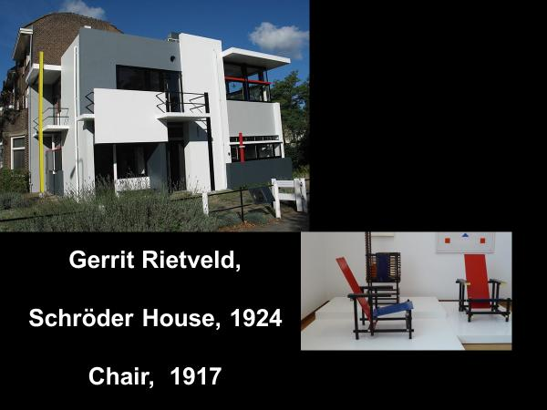

Slide 5
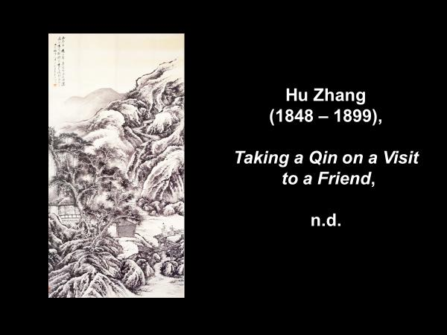

Slide 6
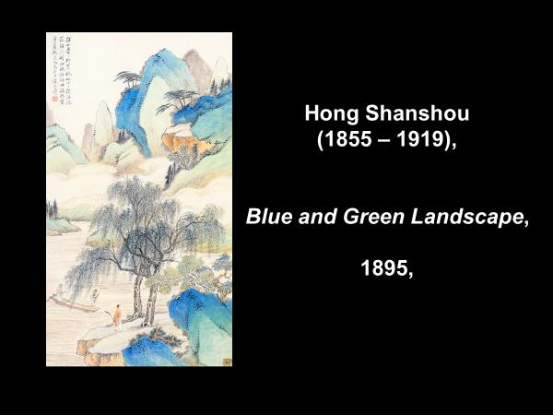

Slide 7
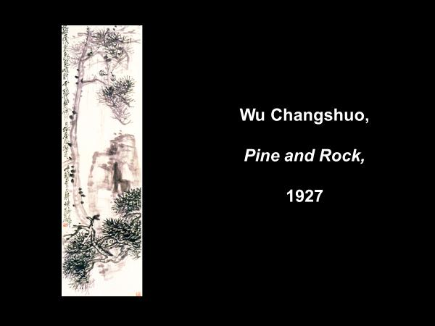

Slide 8
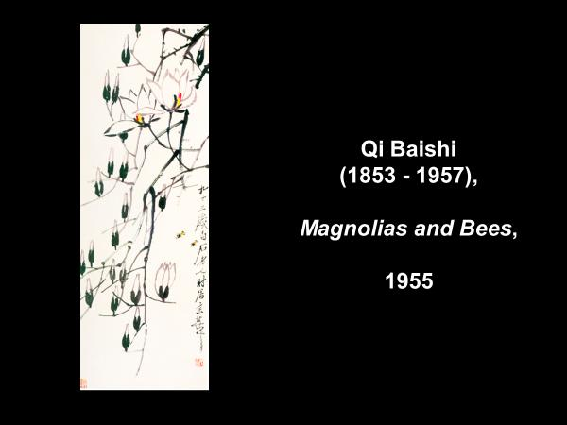

Slide 9
Academies
& Academics

Slide 10
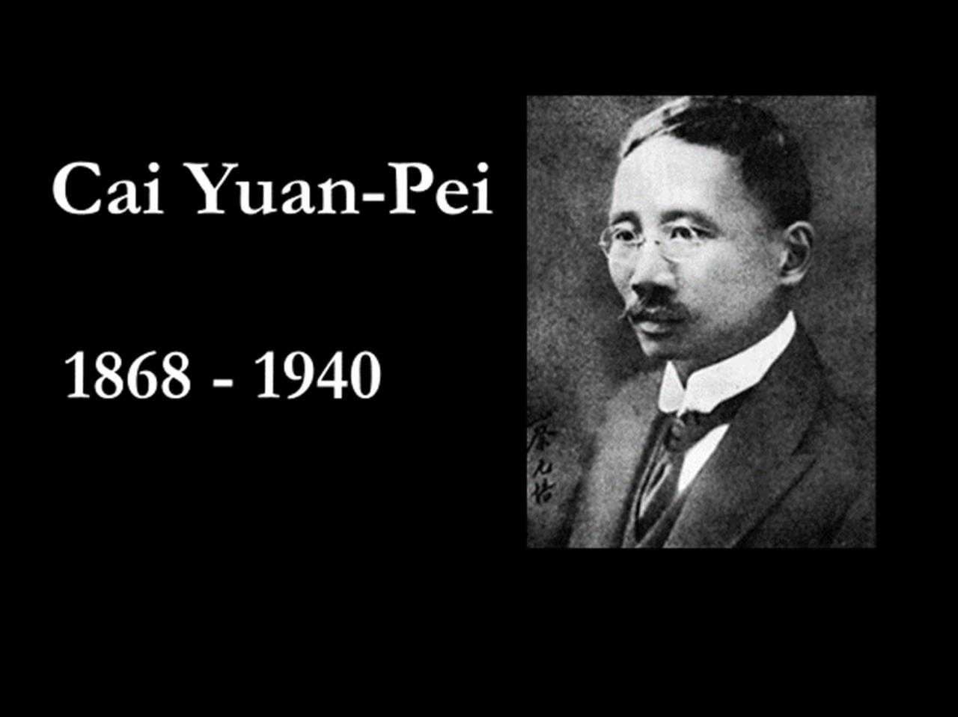

Slide 11
Cai Yuan-Pei
1912 Minister of Education
Military Education
Utilitarian Education
Moral Education
World Outlook Education
Aesthetic Education (meiyu)

Slide 12
Cai Yuan-Pei
1917 Chancellor of Peking University
“On Replacing Religion
with Aesthetic Education”
1918 Beijing Art School
1920 Shanghai Art Academy

Slide 13
Cai Yuan-Pei
1927 Chancellor,
National University System
1928 National Hangzhou
Arts Academy

Slide 14
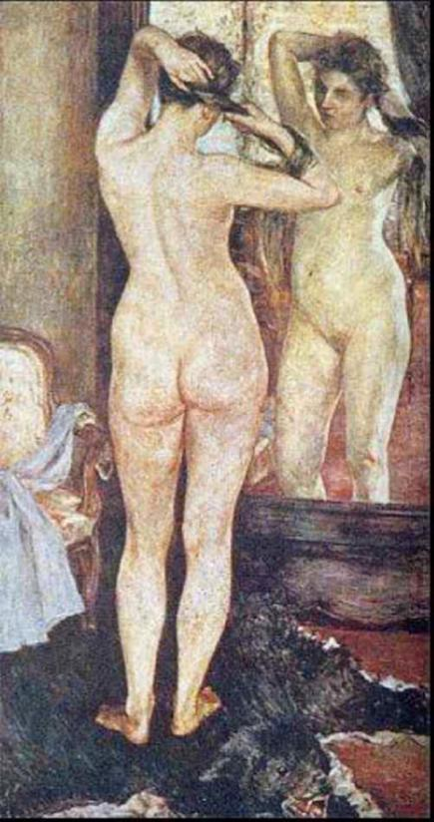
Kuroda Seiki,
Morning Toilette,
1893

Slide 15
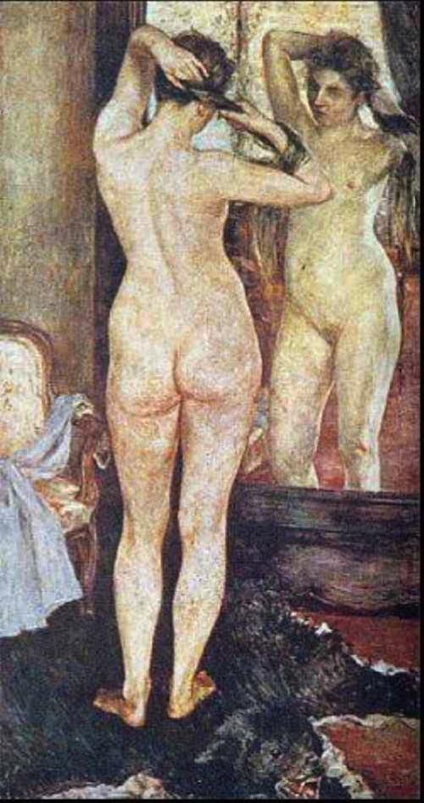

Slide 16
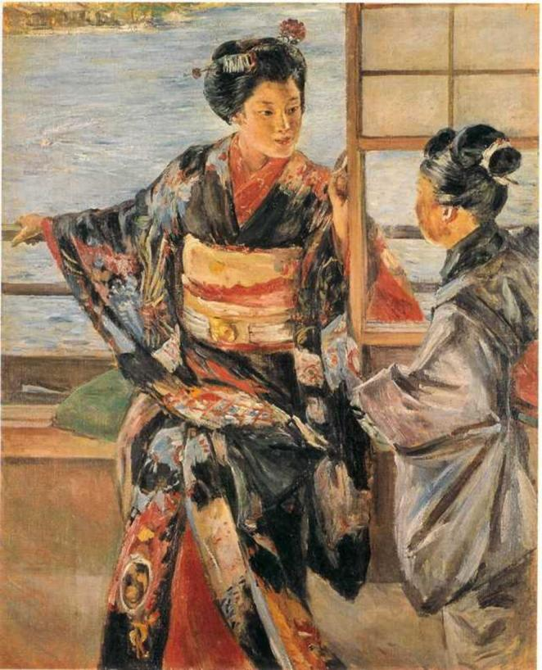
Kuroda Seiki,
Maiko,
1893

Slide 17


Slide 18
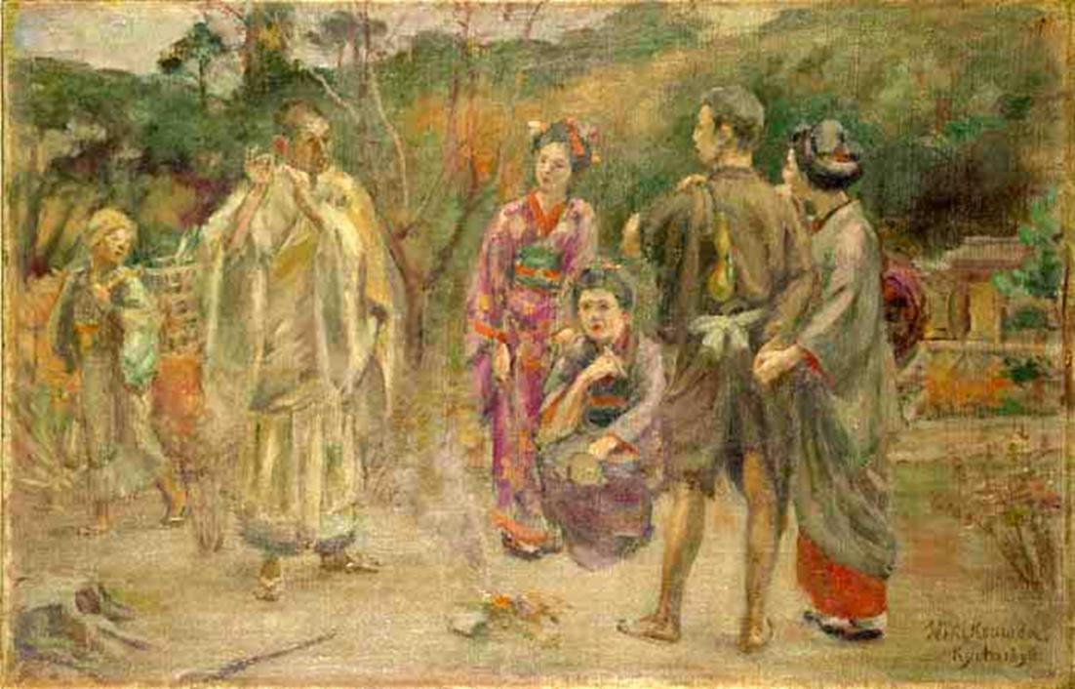
Kuroda Seiki,
Talk of Ancient Romances, 1888

Slide 19


Slide 20
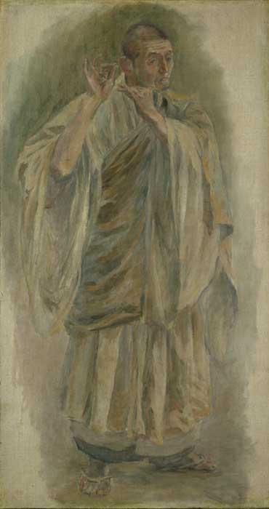
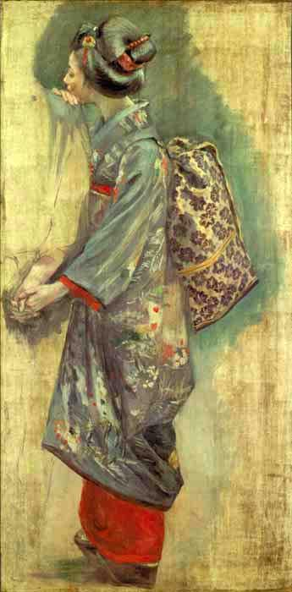

Slide 21
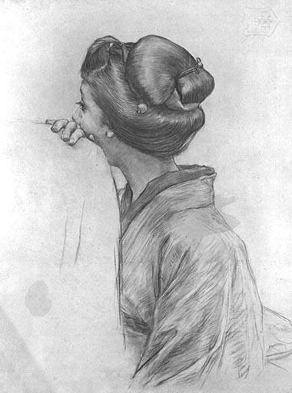
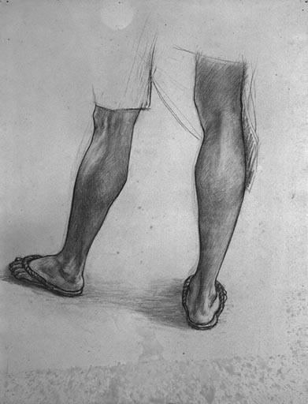

Slide 22
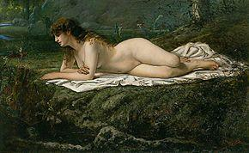
Yamamoto Hōsui,
Nude Study, 1880s

Slide 23
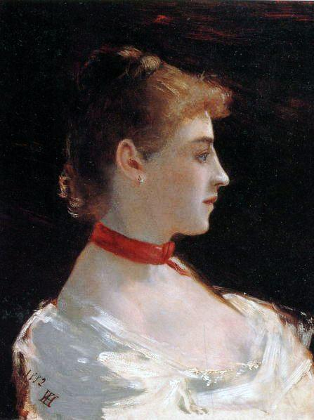
Yamamoto Hōsui,
Portrait of
Judith Gautier,
1882

Slide 24
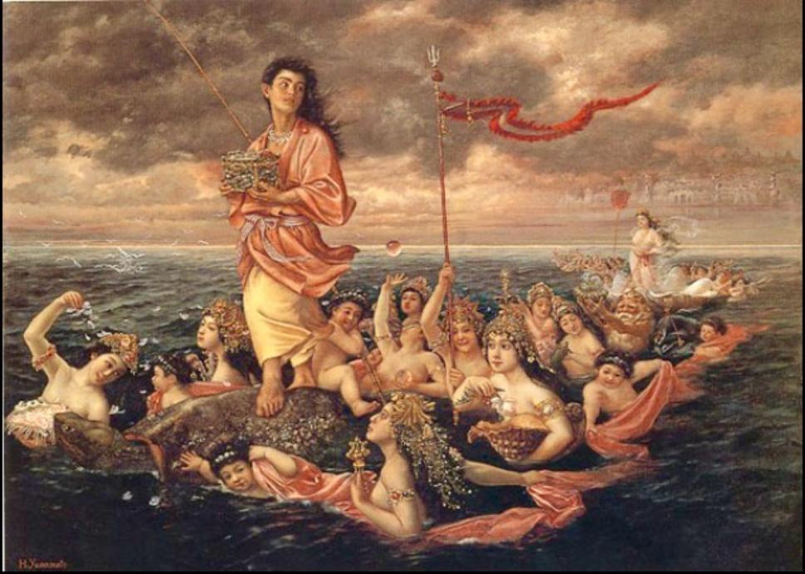
Yamamoto Hōsui,
Urashima-zu, 1895

Slide 25


Slide 26
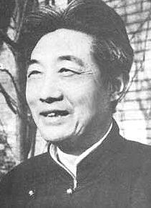
Xu Beihong
1895 - 1953

Slide 27
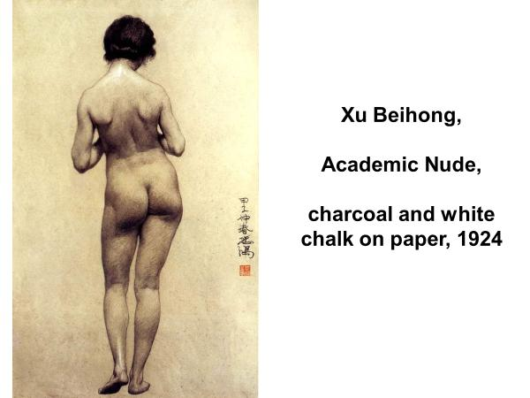

Slide 28
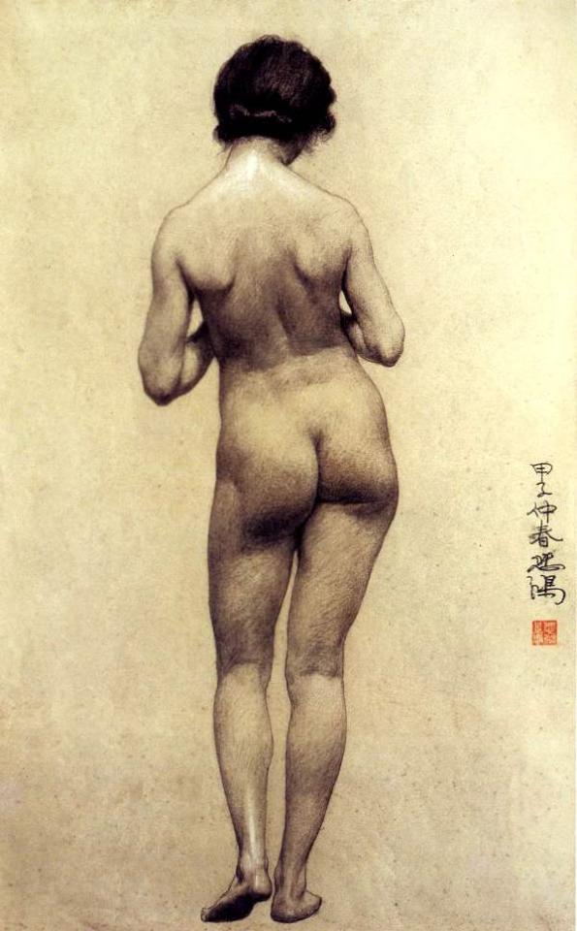

Slide 29
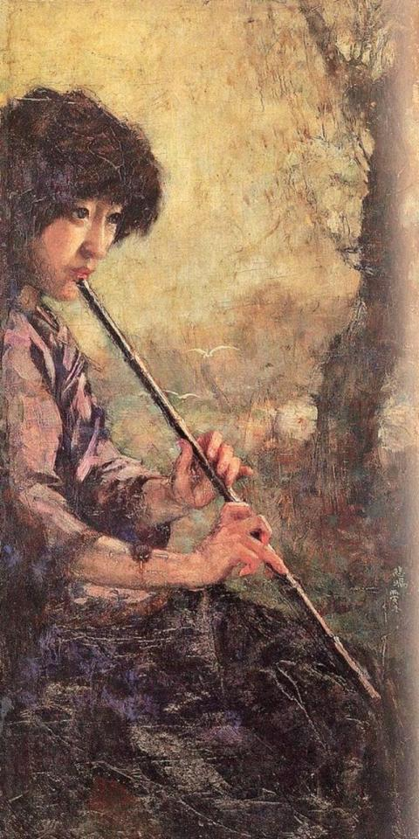
Xu Beihong,
The Sound of the Flute,
1926

Slide 31
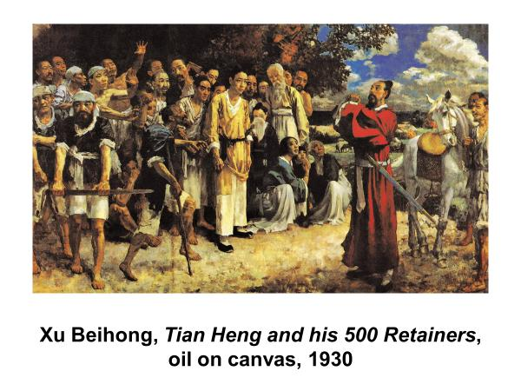

Slide 32
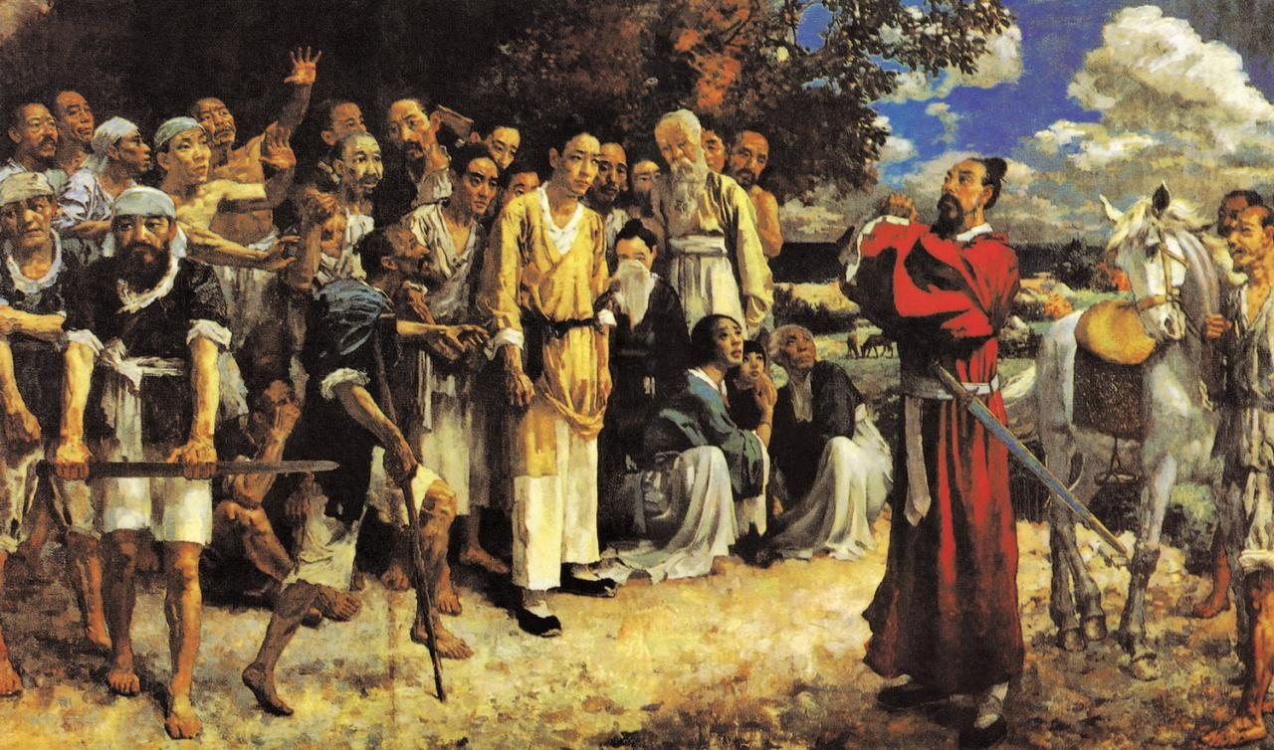

Slide 33
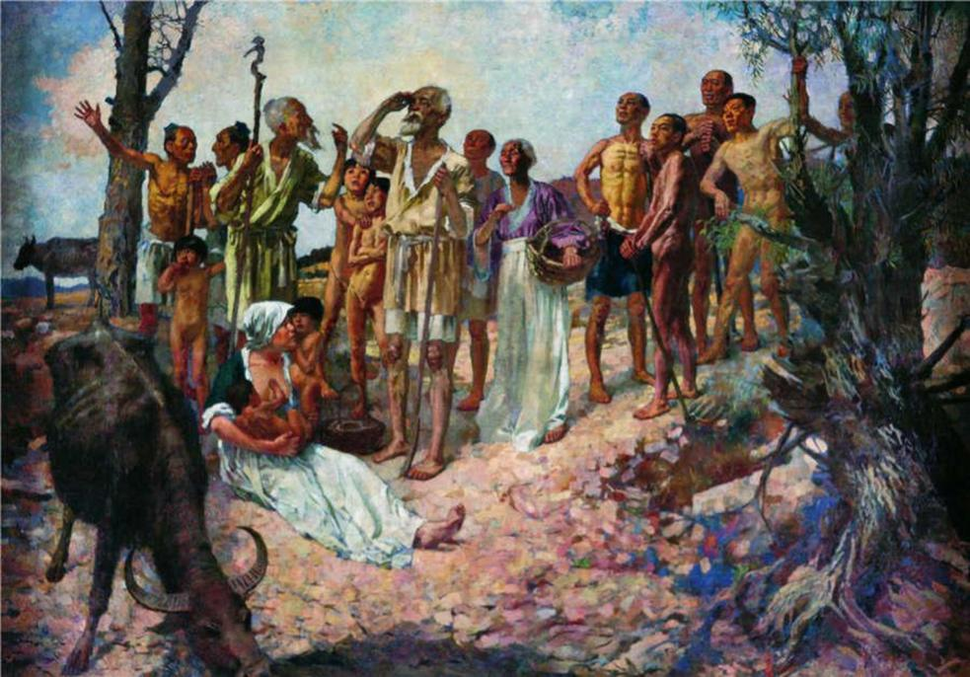
Xu Beihong, Xi Wo Hou, 1933

Slide 34


Slide 35
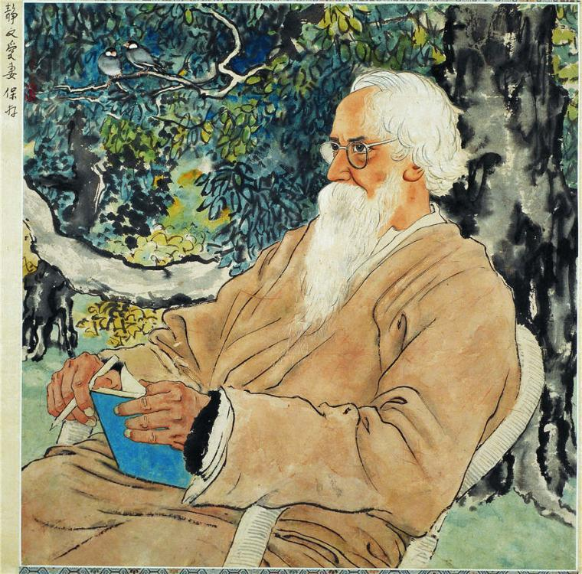
Xu Beihong,
Portrait of Rabindranath Tagore,
1940

Slide 37
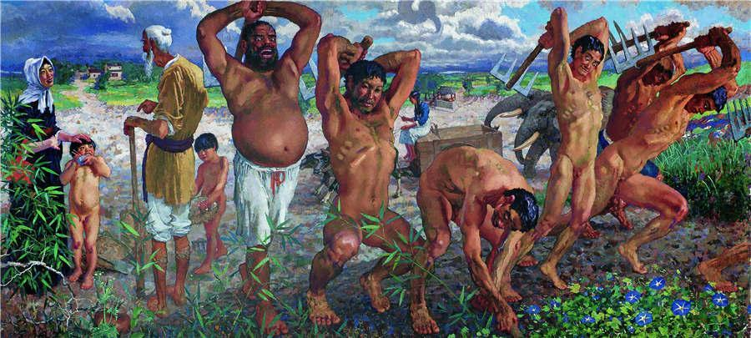
Xu Beihong,
The Foolish Old Man Who Moved the Mountains, 1940

Slide 38
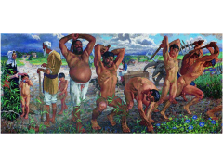


Slide 39
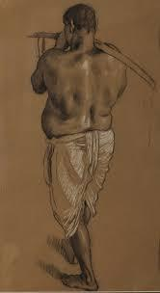
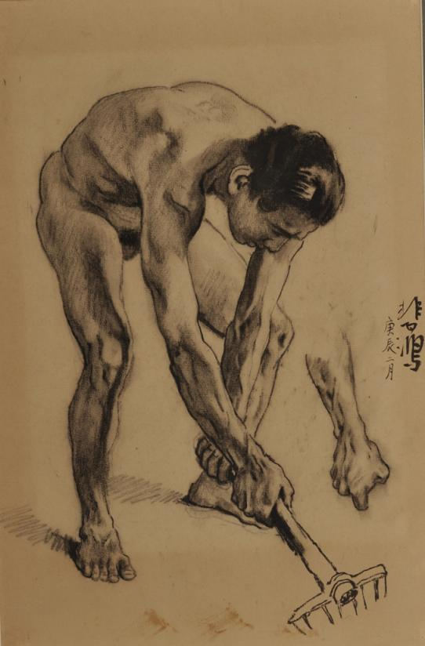

Slide 40
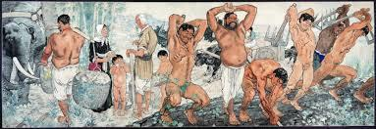

Slide 41
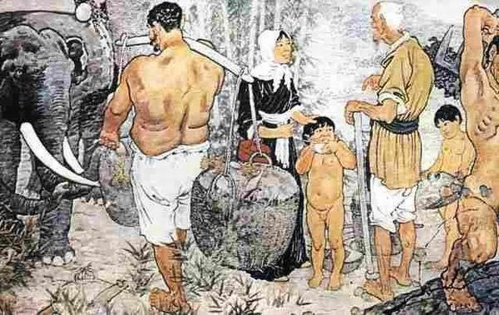

Slide 42
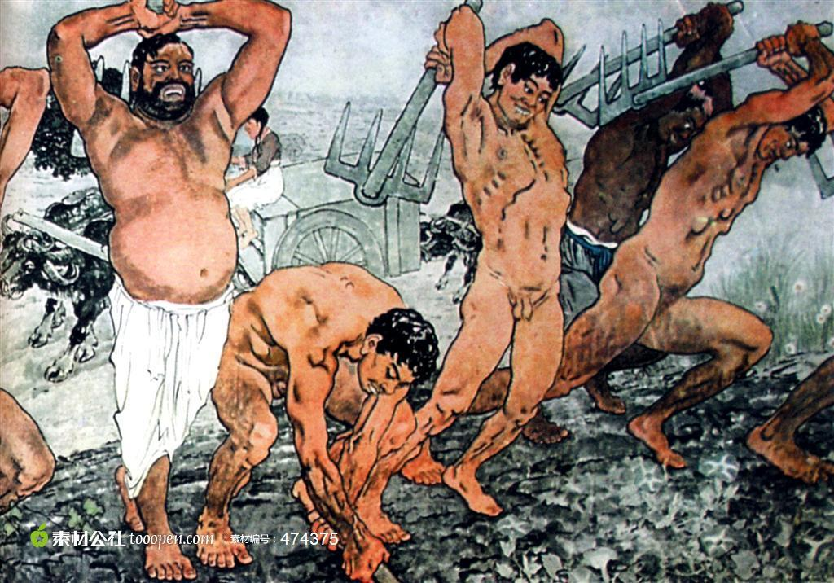

Slide 43
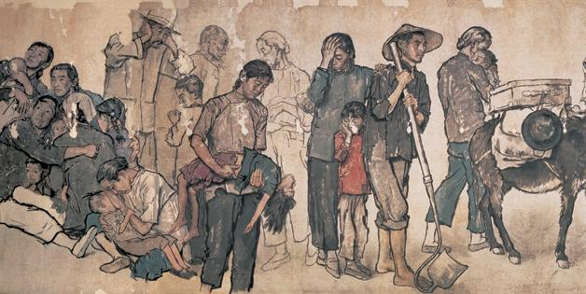
Jiang Zhaohe,
Refugees, 1943

Slide 44
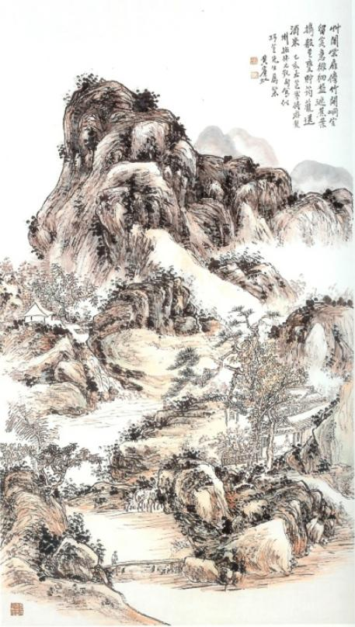
Huang Binhong,
Entertaining a Friend
in a Mountain Dwelling.
1935

Slide 46
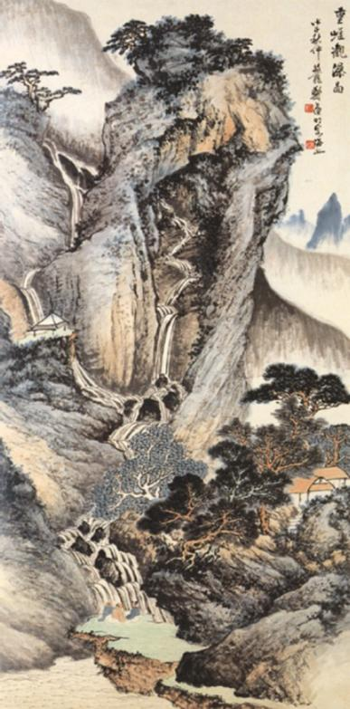
Zheng Wuchang,
Gazing at the Waterfall,
1949

Slide 47
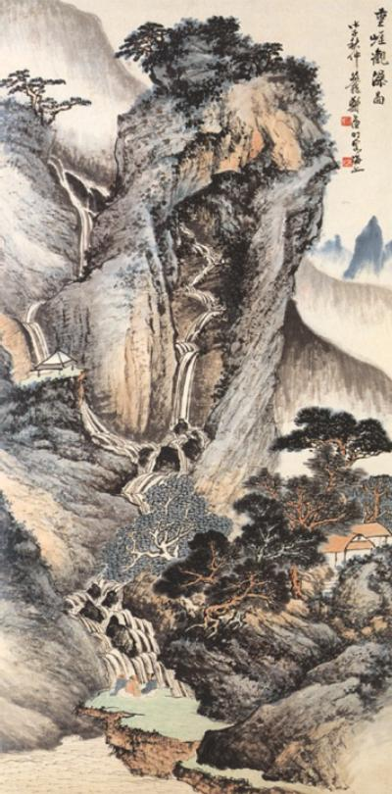

Slide 48
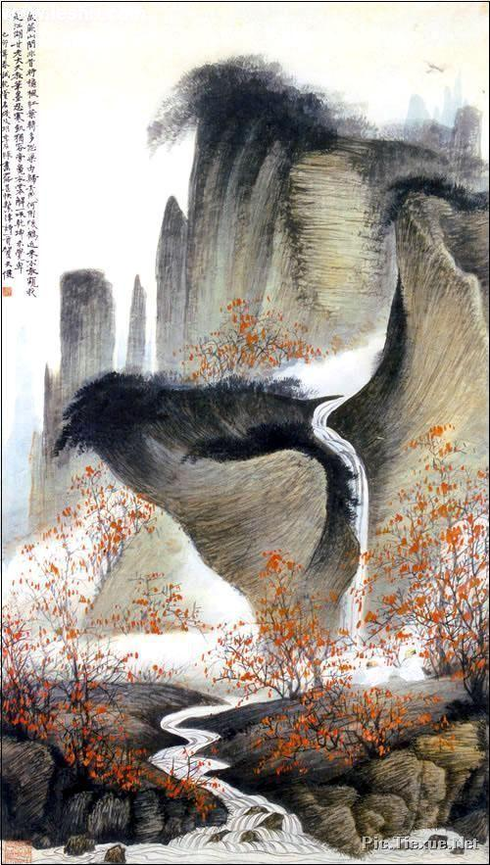
He Tianjian,
Conversation
in the Autumn Woods,
1939

Slide 50
Revolution
& Revolutionaries

Slide 51
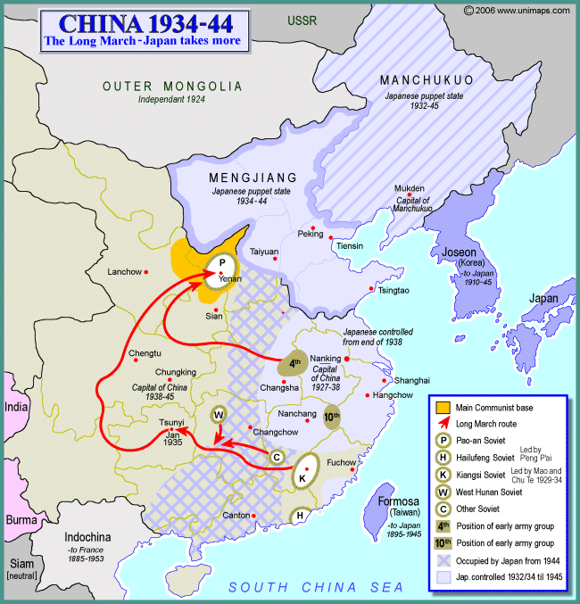

Slide 52
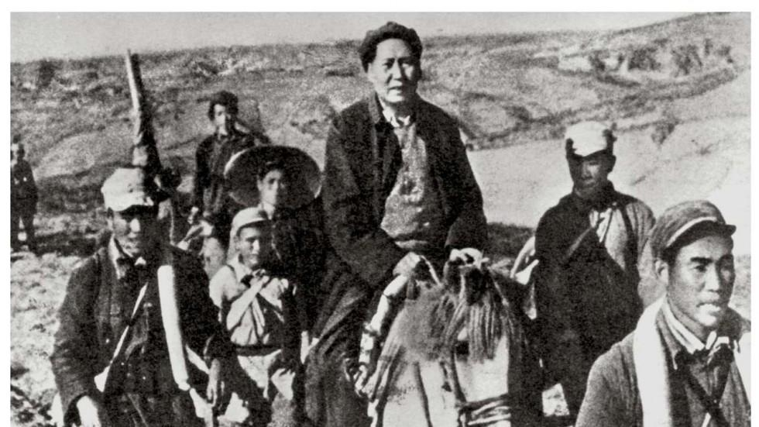

Slide 53
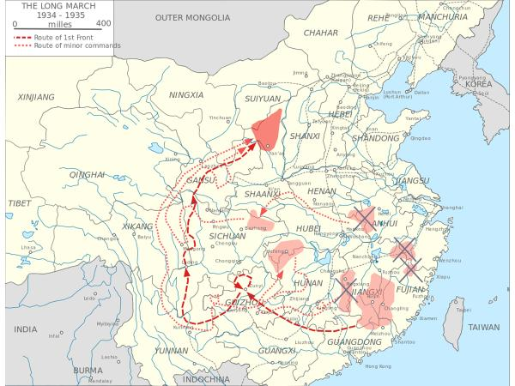

Slide 54
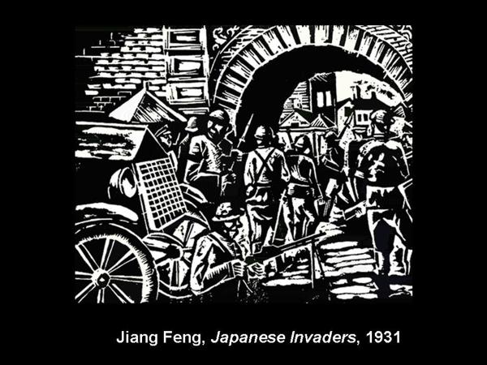

Slide 55
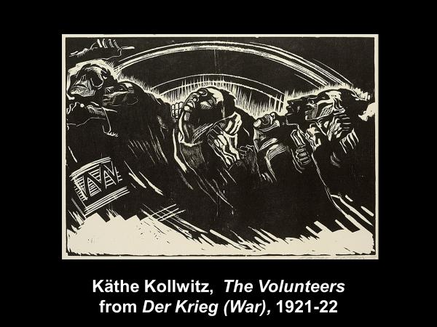

Slide 56
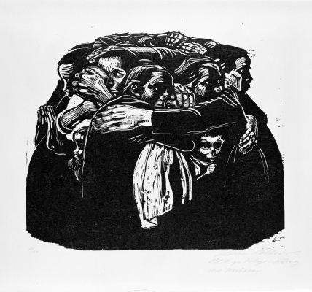
Käthe Kollwitz,
The Mothers,
1919

Slide 57
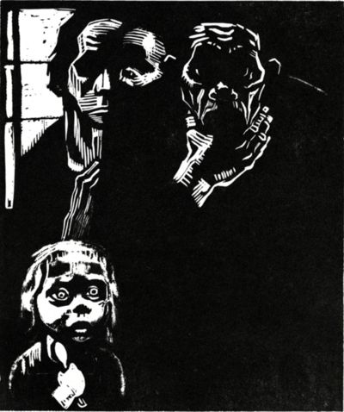
Käthe Kollwitz,
Unemployed,
1925

Slide 58
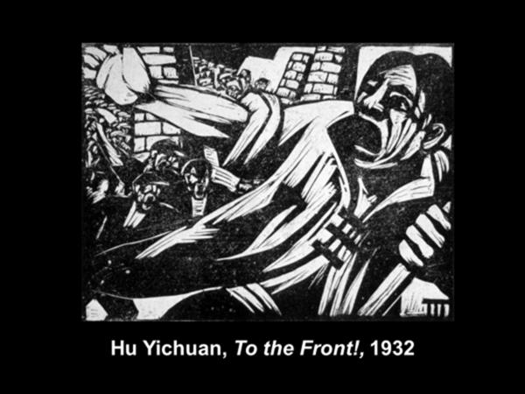

Slide 59
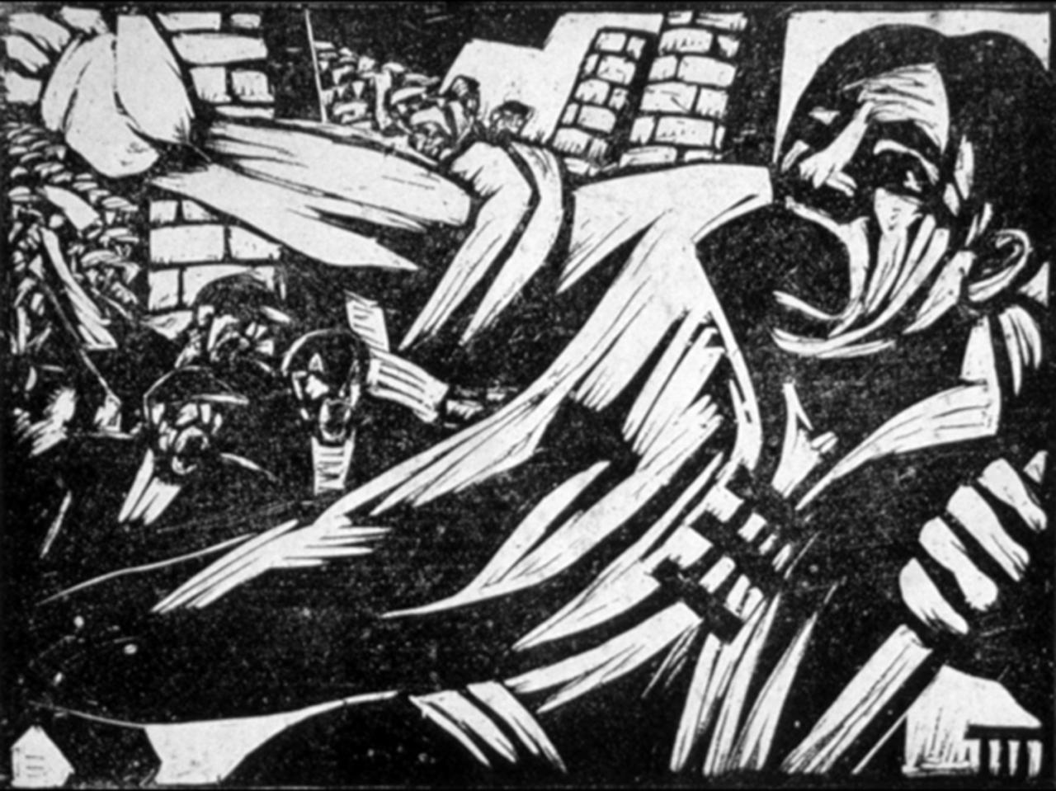

Slide 60
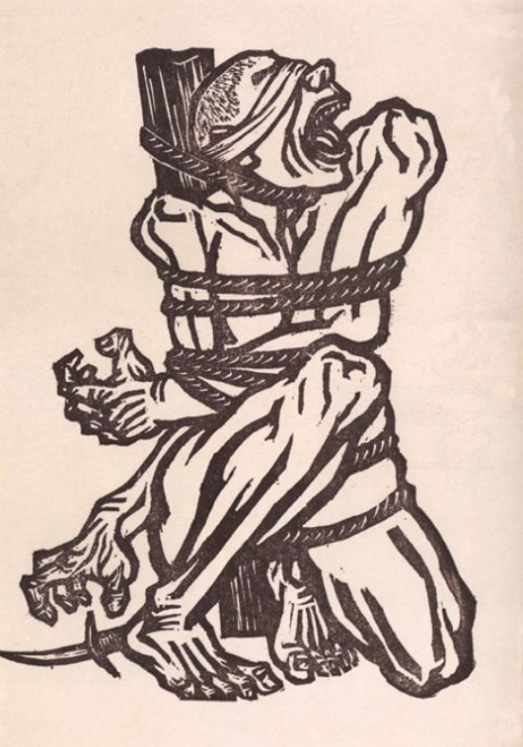
Li Hua,
China, Roar!
1936

Slide 62

Huang Xinbo,
He Hasn’t Really Gone, 1941

Slide 64


Slide 65

Yan Han,
Cooperation between the Army and
the People,
1939

Slide 66


Slide 67


Slide 68
Xu Beihong
1949 President of CAFA
(Central Academy of Fine Art)
&
Chairman,
China Artists’ Association
(d. 1953)

Slide 69


Slide 70


Slide 71


Slide 72


Slide 73


Slide 74


